Slide 1
Cups 2025 and beyond

Slide 2
IYSA CUPS: State Cup – Top Tier Gem State – Open U9 – U15 tournament Directors Cup – Tier 2 event

Slide 3
State Cup – GOALS
Minimize travel because of cost associated with travel.
Keep the PDI’s where possible
Opportunities earned through play performance, Inclusive of all to earn that opportunity.
2 weekend max for Cup play (separate from qualifier play)
8 teams max for Cup play
Qualifiers regionally based
Set Distribution of teams qualifying based on member population in each district

Slide 4
Cup Format 2.0
Qualifying
Single RR play
Can count IYSA/USYS sanctioned league play if both teams agree 14 days or greater prior to game.
Rule that you must participate in IYSA sanctioned league play to be eligible.
North Division
East Division
South Division
West Division
Cup Team distribution
8 team max
4 – District 3
1 – District 1
2 – District 2
1 – District 4
Weekend 1 – RR play (Friday/Saturday/Sunday)
Weekend 2 – Semi/Final/3rd place game (Saturday/Sunday)

Slide 5
Qualification Format
Qualification can be done whenever convenient for the district (scheduled by IYSA) but must be done at least 2 weeks prior to the first round of the event to allow for rosters to be built and processed and travel arrangements made where necessary.
After the qualification process teams within the district will be seeded in the main event based on their positional qualifying and a draw that will place those seeds.
1 team division - Default winner
2 team division - Single game
3 team division - Single weekend (2 games)
4 team division – Single weekend (3 games)
5 team division – 2 weekends (2 games each weekend)
6 team division – 2 weekends (3/2 split on each weekend)
7 team division – 2 weekends (3 games each weekend)
OR League format Fall/Spring U12- U14. U15+ Spring only 1 game per weekend

Slide 6
Seeding allocation
Any unused seed will be allocated to another district. The order of this allocation will be determined by a draw. At each age group and gender, Districts will be drawn at random and placed in the 1st, 2nd, 3rd, or 4th position
This will produce a draw matrix like the one below.
After the entry deadline, using the matrix as a reference, it will be determined who gets the extra seed(s).
Example 1: District 2 does not have a 2nd seed at U12B, so the available seed goes to District 1.
Example 2: District 2 does not have a 2nd seed at U13B so that would go to District 3 as they are next in line

Slide 7
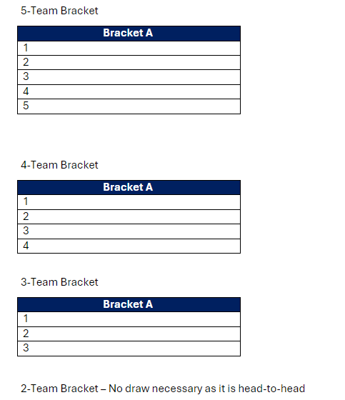
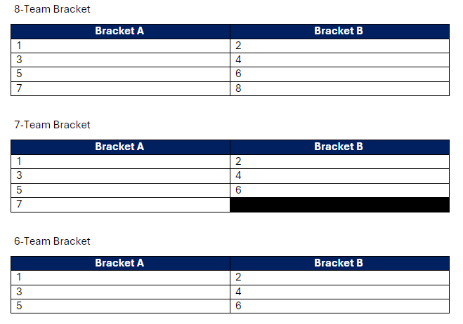
Event Seed Draw
Once the qualification process is over, there will be a draw to determine which seed goes where in the brackets. This draw will take place either in person or via video conference, on a date determined by IYSA.
Teams from the same club can’t be drawn in the same bracket unless there is no place to put them. Should a team from the same bracket be drawn then they will be placed at the next slot number to be drawn
Each age group will be drawn separately, and the slot order will be as follows.

Slide 8
Directors Cup - Spring
Tier 2 event
No SC bracket teams can participate
Teams not moving on from qualifiers CAN participate
Will potentially move to later depending on IYSA leagues spring play

Slide 9
Gem State - Fall
Open event
U9 – U15
Open to any level IYSA member

Slide 10
STATE CUP Dates: Round Robin Play: April 26-28* CUP Semis/Finals: May 17 - 18 *Means that qualifying must been done by April 11-13.

Slide 11
Thank you

